Slide 1
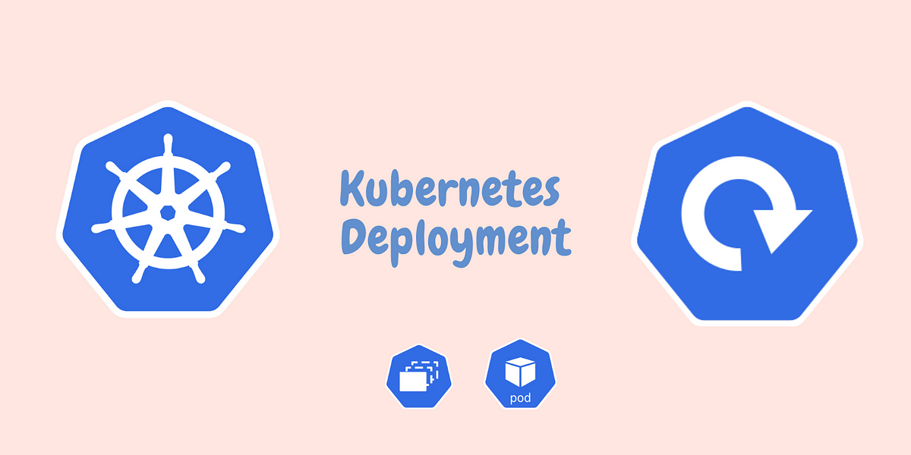
A
MINOR PROJECT
ON
KUBERNETES DEPLOYMENT
SUBMIT BY :-
RINKU SHARMA
SUBMIT TO :-
ASHISH MITTAL

Slide 2
TABLE OF CONTENT
Introduction to Kubernetes deployment
Key concept of Kubernetes deployment
Kubernetes deployment process
Managing Kubernetes deployment
Scaling and autoscaling with Kubernetes deployment
Hands on practice

Slide 3
Introduction to Kubernetes deployment
Kubernetes deployment refers to the process of managing and running applications on a Kubernetes cluster. It involves defining the desired state of your application, including the number of replicas, networking, and resource requirements, and then letting Kubernetes handle the orchestration and management of the application

Slide 4
Key concept of Kubernetes deployment
Pods
Pelicaset
Deployment
Service
Config map
Secrets
Horizontal pod autoscaling (HPA)
Rolling updates
Statefulsets
Daemonset
Namespace
Labels and selectors

Slide 5
Kubernetes deployment process
Containerize the Application:
Create a Docker image of your application or choose an existing image from a container registry.
Ensure the image contains all the necessary dependencies and configurations.
2.Define Deployment Configuration:
Create a deployment configuration file in YAML format. This file describes the desired state of your application.
Specify details such as the container image, number of replicas (pods), resource limits, networking, and other settings.
3.Apply the Configuration:
Use the Kubernetes command-line tool (kubectl) or other Kubernetes management tools to apply the deployment configuration.
The configuration file is applied to the Kubernetes API server, which updates the desired state of the application

Slide 6
4.Kubernetes Scheduler:
The Kubernetes scheduler assigns the pods to available nodes in the cluster based on resource availability and constraints.
The scheduler ensures that the desired number of replicas specified in the deployment configuration are created and distributed across the cluster.
5.Pod Creation and Scaling:
Kubernetes creates the specified number of pods, each running an instance of the containerized application.
Pods are created and scheduled on worker nodes in the cluster. Each pod has a unique IP address and can communicate with other pods.
6.Service Creation:
Optionally, you can create a Kubernetes Service to provide a stable network endpoint for accessing your application.
Services enable load balancing and routing traffic to the underlying pods, ensuring high availability.

Slide 7
7.Monitoring and Scaling:
Monitor the deployed application using Kubernetes-native monitoring tools like Prometheus and Grafana or other monitoring solutions.
Use Kubernetes scaling features to adjust the number of replicas based on the workload. This can be done manually or by setting up autoscaling based on resource utilization metrics.
8.Rolling Updates and Rollbacks:
To update the application, make changes to the deployment configuration file, such as updating the container image version.
Apply the updated configuration, and Kubernetes will perform a rolling update, gradually replacing old pods with new ones, ensuring minimal downtime.
If issues arise during the update, Kubernetes supports rollbacks, allowing you to revert to the previous known working state.
9.Continuous Integration/Deployment (CI/CD):
Integrate Kubernetes deployment into your CI/CD pipeline to automate the application deployment process.
CI/CD tools can build container images, push them to a container registry, and trigger the deployment process

Slide 8
Managing Kubernetes deployment
Use YAML or JSON configuration files to define the desired state of your application deployment.
Apply the deployment configuration using the Kubernetes API (e.g., kubectl apply -f <config-file>).
Monitor the deployment using Kubernetes tools like kubectl, Kubernetes Dashboard, or dedicated monitoring solutions.
Scale your application horizontally by adjusting the number of replicas (pods) manually or using autoscaling based on resource utilization metrics.
Perform rolling updates to update your application without downtime by gradually replacing old pods with new ones.
Use Services to provide a stable network endpoint for accessing your application and enable load balancing across pods.
Utilize ConfigMaps and Secrets to manage application configurations and sensitive data securely.
Implement logging and monitoring solutions to collect and analyze logs and metrics from your application and cluster.
Ensure security by applying RBAC, network policies, and regularly updating Kubernetes and container images.
Integrate Kubernetes deployment into your CI/CD pipeline for automated and streamlined application deployment.

Slide 9
Scaling and autoscaling with Kubernetes deployment
Scaling in Kubernetes involves adjusting the number of replicas (pods) running your application based on workload or resource utilization.
Horizontal Pod Autoscaling (HPA) automatically scales the number of pod replicas based on CPU or custom metrics, ensuring optimal resource allocation.
Vertical Pod Autoscaling (VPA) adjusts the CPU and memory resources allocated to individual pods based on their usage patterns.
Autoscaling eliminates the need for manual intervention, ensuring your application can handle varying traffic demands efficiently.
Kubernetes allows you to define scaling thresholds and policies to control the scaling behavior of your application.
Scaling can be performed manually using the Kubernetes API or automatically using built-in autoscaling features or external tools.

Slide 10
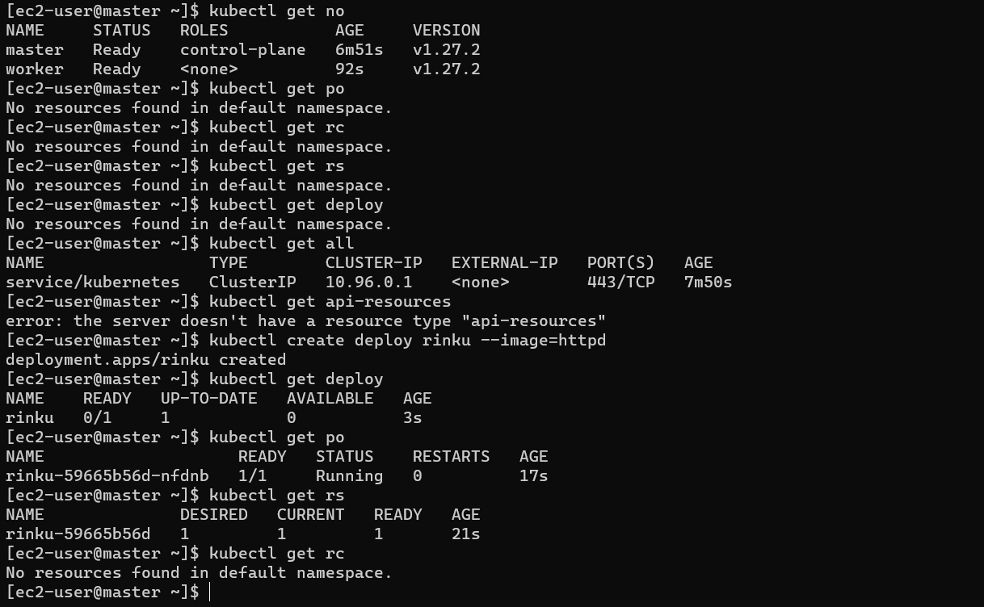
Hands on practice

Slide 11


Slide 12
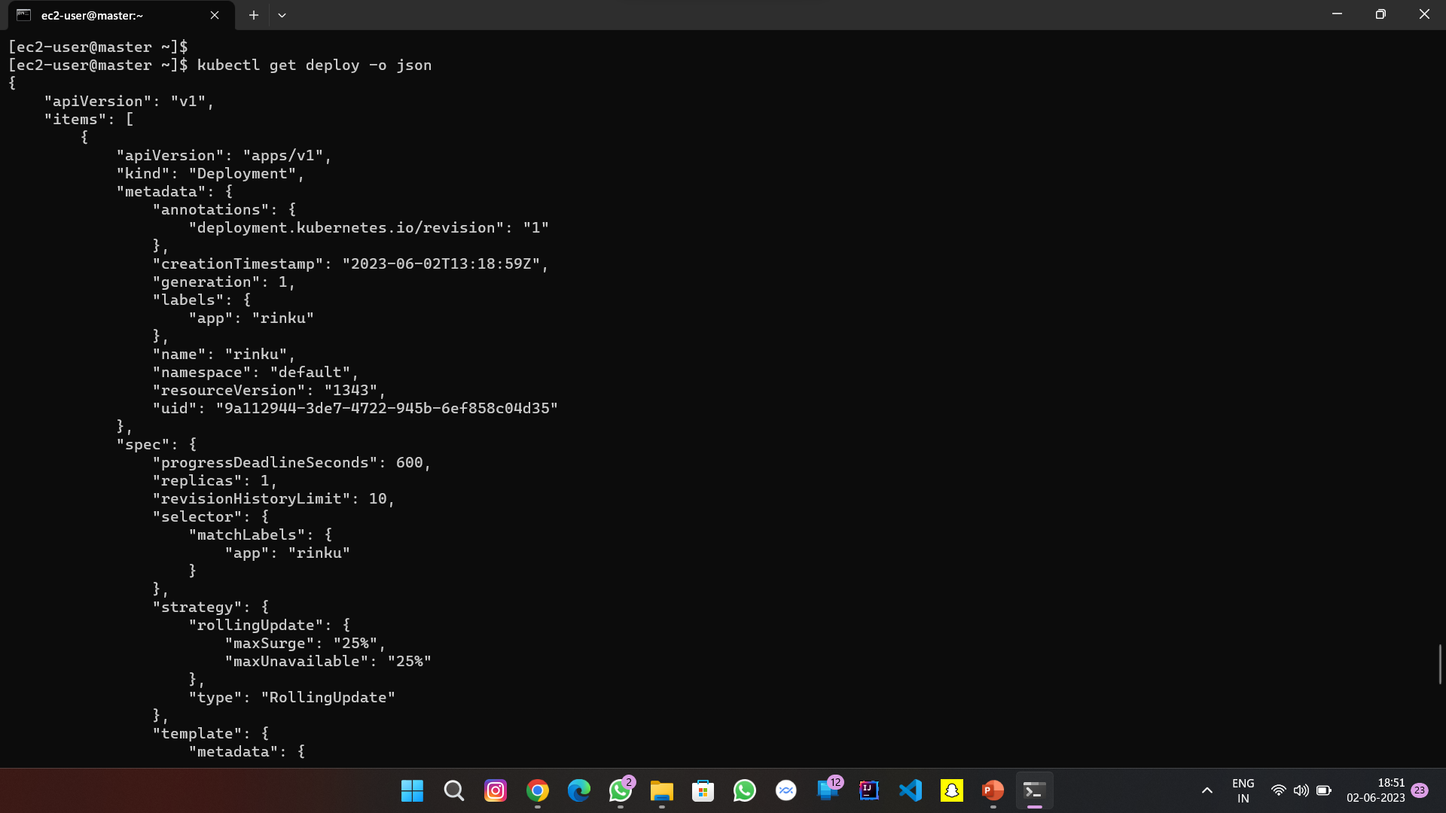

Slide 13
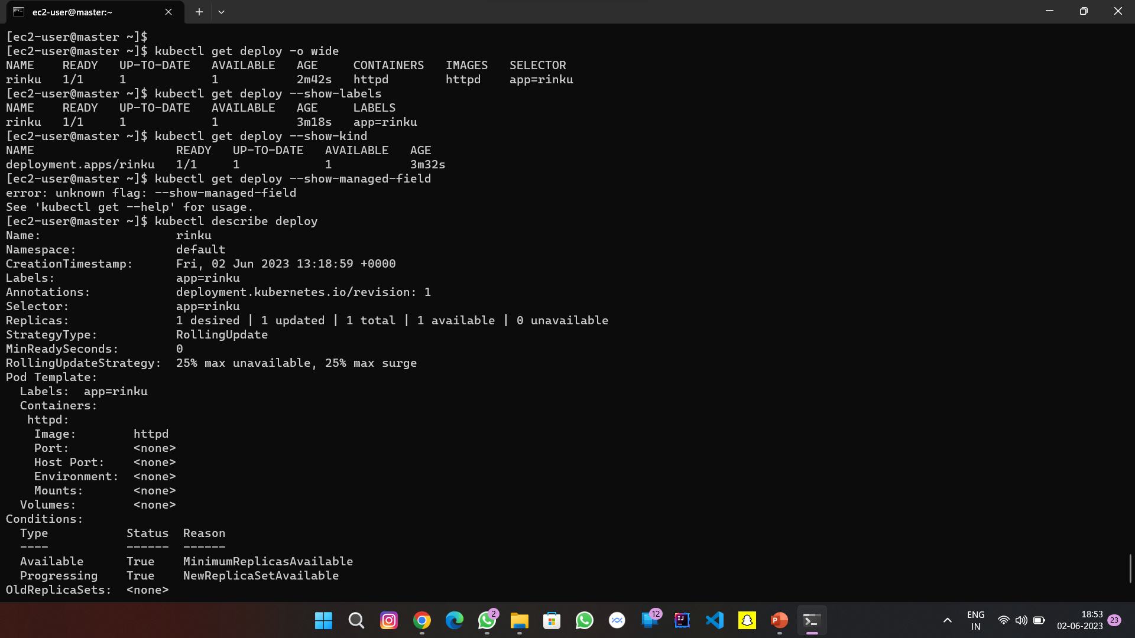

Slide 14
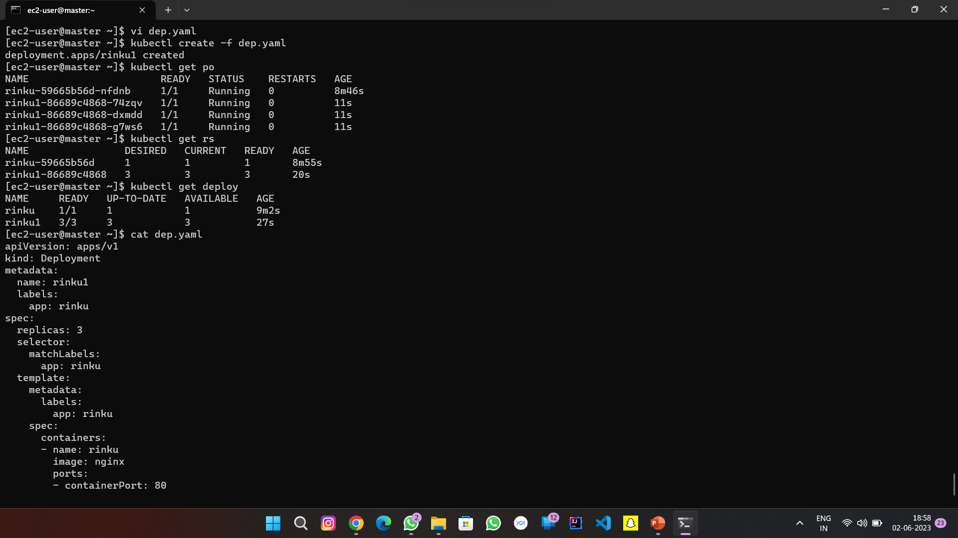

Slide 15
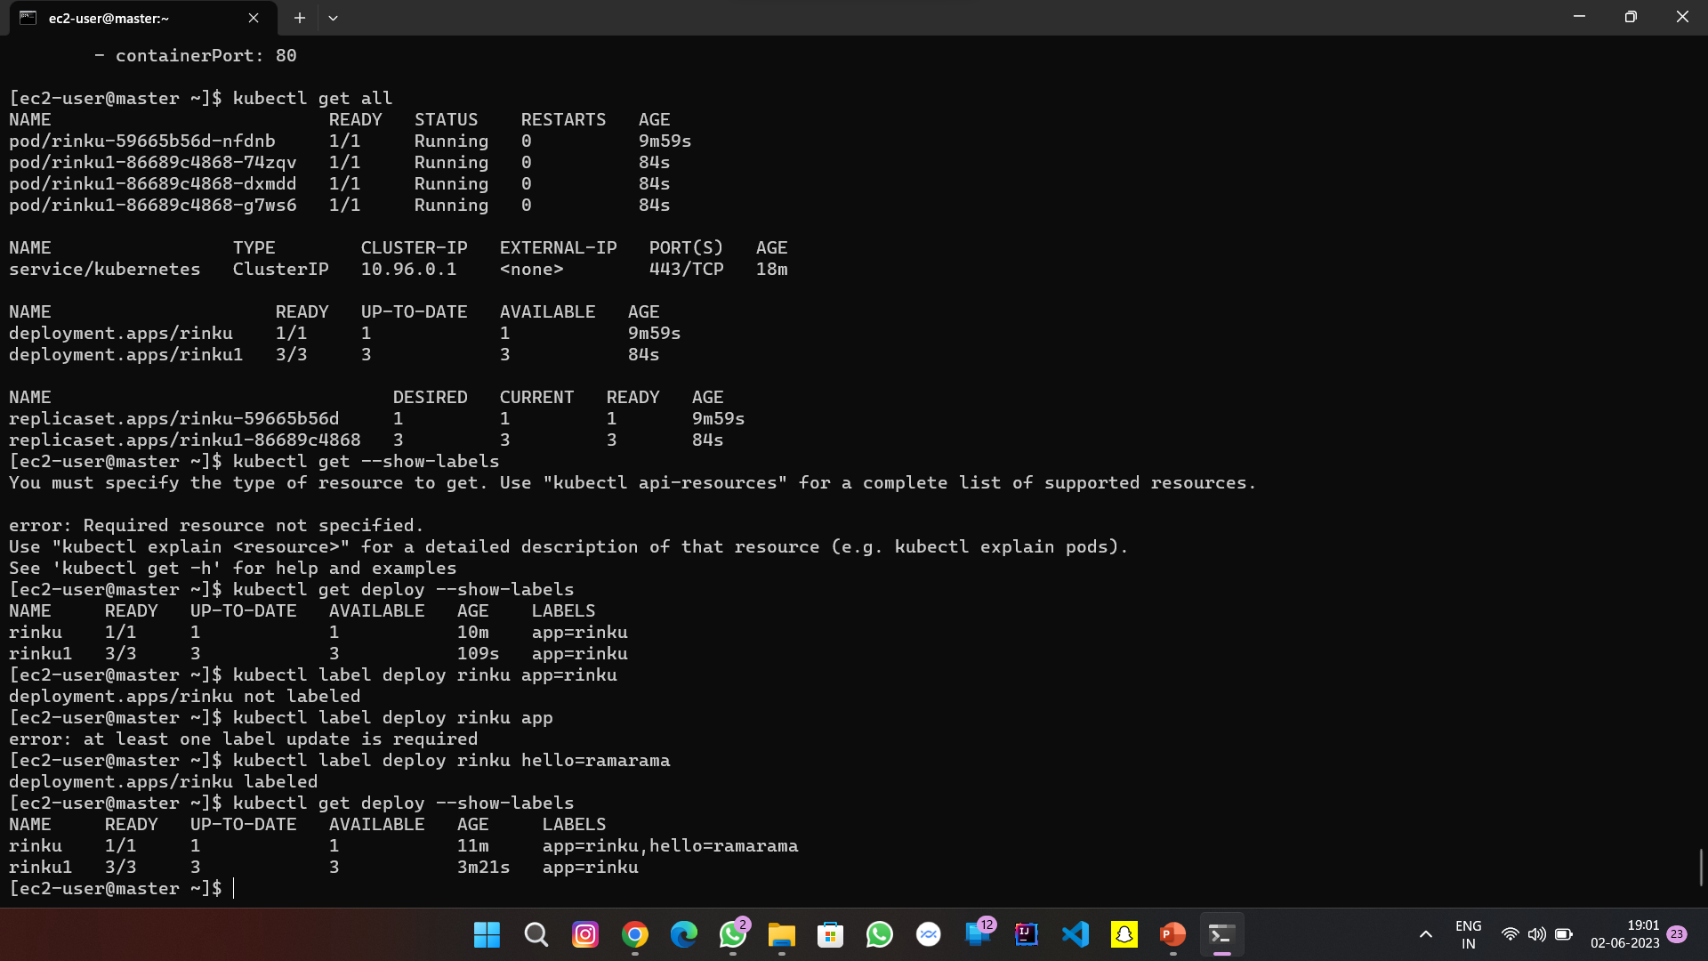

Slide 16
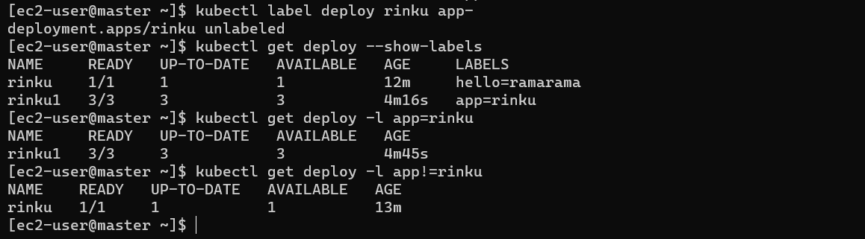

Slide 17
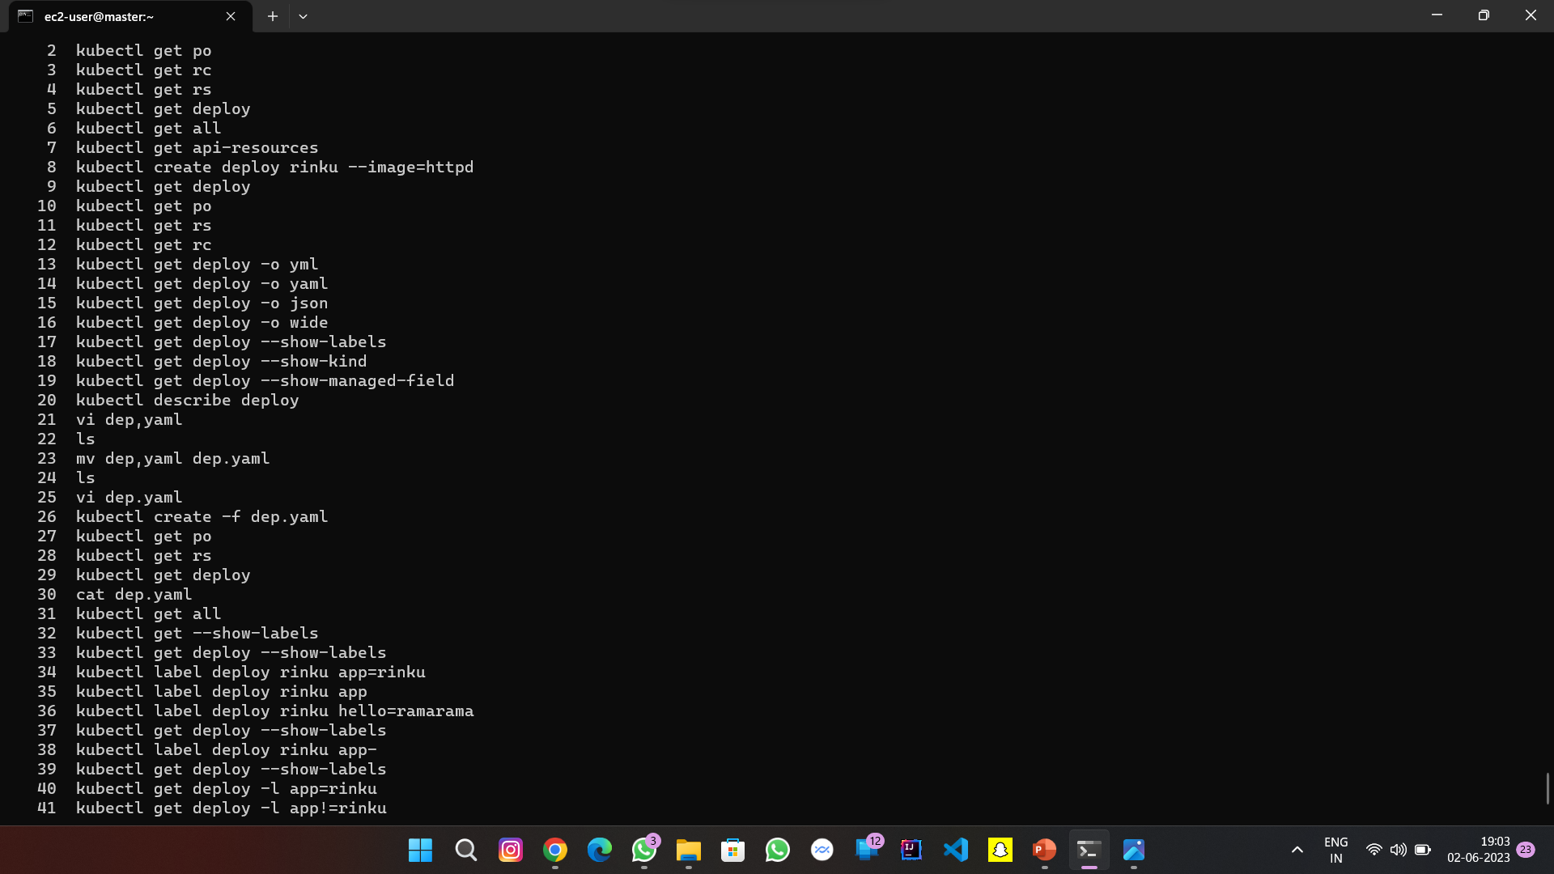

Slide 18


